Slide 1
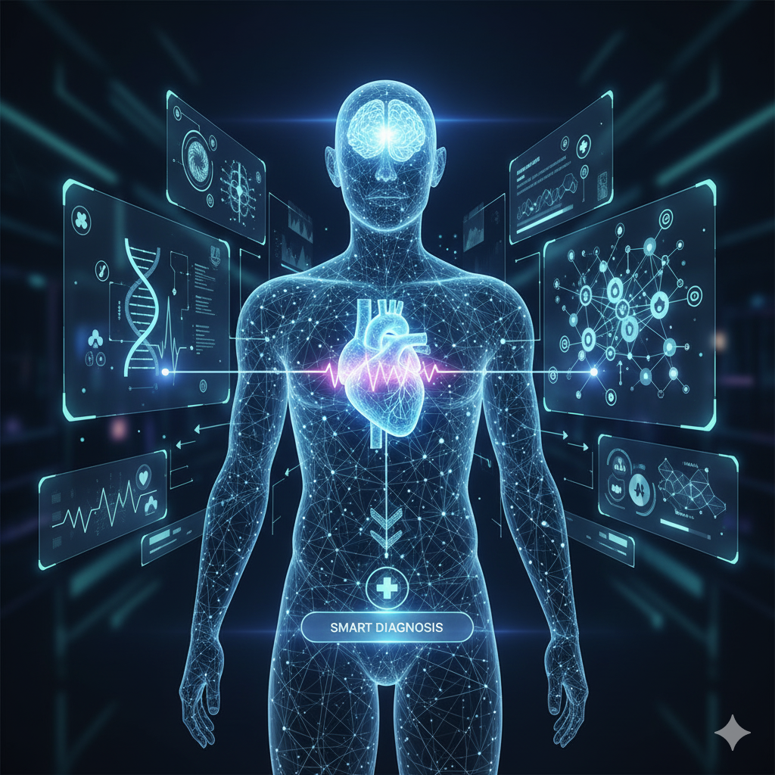
MoM: AI Based Personalized Health Assessment System
Introducing MoM, an innovative interactive health assistant designed to revolutionize how patients report symptoms and receive preliminary health assessments. By combining intuitive visual reporting with advanced AI analysis and critical human validation, MoM ensures a trustworthy, safe, and effective healthcare experience for all.

Slide 2

The Challenge: Interpreting Symptoms is Hard
Patient Interpretation Struggles
Patients often find it difficult to accurately interpret and articulate their symptoms, leading to miscommunication or missed details during initial self-assessment.
Social Fear & Judgment
Many individuals fear judgment or stigma associated with certain symptoms, leading to hesitation in seeking help or providing complete information.
Need for Trust & Validation
In health matters, patients require constant validation and trust, especially when relying on technological assessments, ensuring confidence in the advice received.
Fragmented Healthcare Systems
Existing healthcare systems often suffer from fragmentation, with disjointed monitoring and information systems hindering seamless patient care.

Slide 3




AI-Powered Insight with Human Validation
MoM leverages the best of both artificial intelligence and human medical expertise to provide precise and reliable health assessments.
Visual Symptom Reporting
Patients interact with an intuitive visual interface, clicking on body parts to report symptoms, simplifying complex descriptions.
AI Analyzes & Clarifies
MoM's AI agent processes patient inputs, analyzes symptom patterns, and asks intelligent clarifying questions to refine the information.
Preliminary Hypothesis
Based on the gathered data, the AI generates a preliminary hypothesis regarding potential conditions, providing a starting point for diagnosis.
Crucially, every AI-generated hypothesis is reviewed and validated by a licensed human doctor before sharing with the patient.

Slide 4








Why Human Validation Matters
Builds Patient Trust
Diagnostic Accuracy
Fosters confidence and trust in AI-assisted healthcare solutions by integrating the reassuring presence of a medical professional.
Ensures the highest level of diagnostic accuracy, minimizing errors and prioritizing patient safety above all else.
Ethical Oversight
Combines Efficiencies
Provides essential ethical oversight, addressing complex cases and ensuring compassionate care that AI alone cannot replicate.
Seamlessly blends the speed and data processing power of AI with the nuanced, irreplaceable clinical judgment of human doctors.

Slide 5


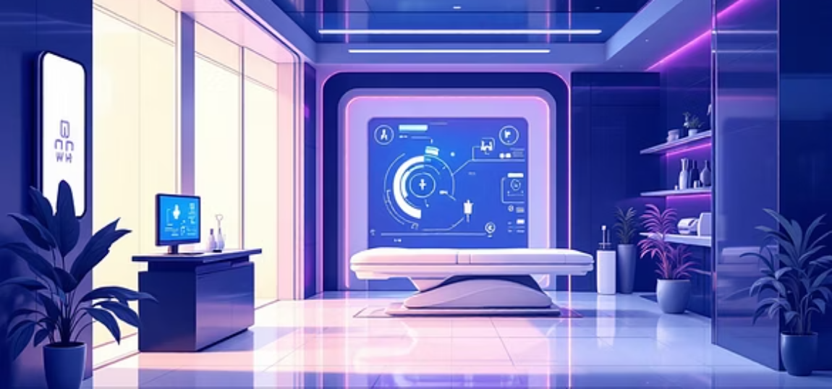
MoM: Empowering Patients, Supporting Doctors, Transforming Care
MoM represents a paradigm shift in healthcare delivery, offering a powerful synergy between technology and human expertise.
1
2
3
Integrated Approach
Future of Health
Addressing Key Needs
Visual symptom reporting, AI intelligence, and human expertise converge to create trusted and effective healthcare solutions.
Join us in shaping a future where technology and humanity collaborate to achieve superior health outcomes for everyone.
MoM addresses the critical demand for unresolved, highly needed, and on-demand personalized health assessment systems.

